Slide 1


SIMATS ENGINEERING
Saveetha Institute of Medical and Technical Sciences Chennai-602105.
Regular Expressions for Real-World Text Processing
Name :K Dedeepya
Reg no:192324252
Course Code:DSA0304
Course Name: Natural Language Processing
Supervisor,
Dr T Devi,
SIMATS Engineering

Slide 2
Introduction
Regular Expressions (Regex) are sequences of characters that define a search pattern. They are used to search, match, validate, and extract information from text. Regex simplifies text processing by automating tasks that would otherwise require manual effort. It is widely used in programming languages such as Python, Java, JavaScript, and C++.
Why Regular Expressions?
Automates text searching.
Validates user input.
Extracts useful information from documents.
Cleans unwanted data.
Saves time by replacing manual text processing

Slide 3
Basic Regex Syntax
Symbol | Meaning | Example
. | Any character | a.c
* | Zero or more | ab*
+ | One or more | ab+
? | Optional | colou?r
[] | Character set | [abc]
^ | Start of string | ^Hello
$ | End of string | World$
\d | Digit | \d{10}
\w | Letter or digit | \w+
\s | White space | \s

Slide 4
Real-World Applications
Applications of Regular Expressions
Email validation
Phone number validation
Password validation
URL extraction
Date format validation
Log file analysis
Data cleaning
Search engines
Chatbots and NLP
Example
Email: student@gmail.com
Phone: 9876543210
URL: https://example.com

Slide 5
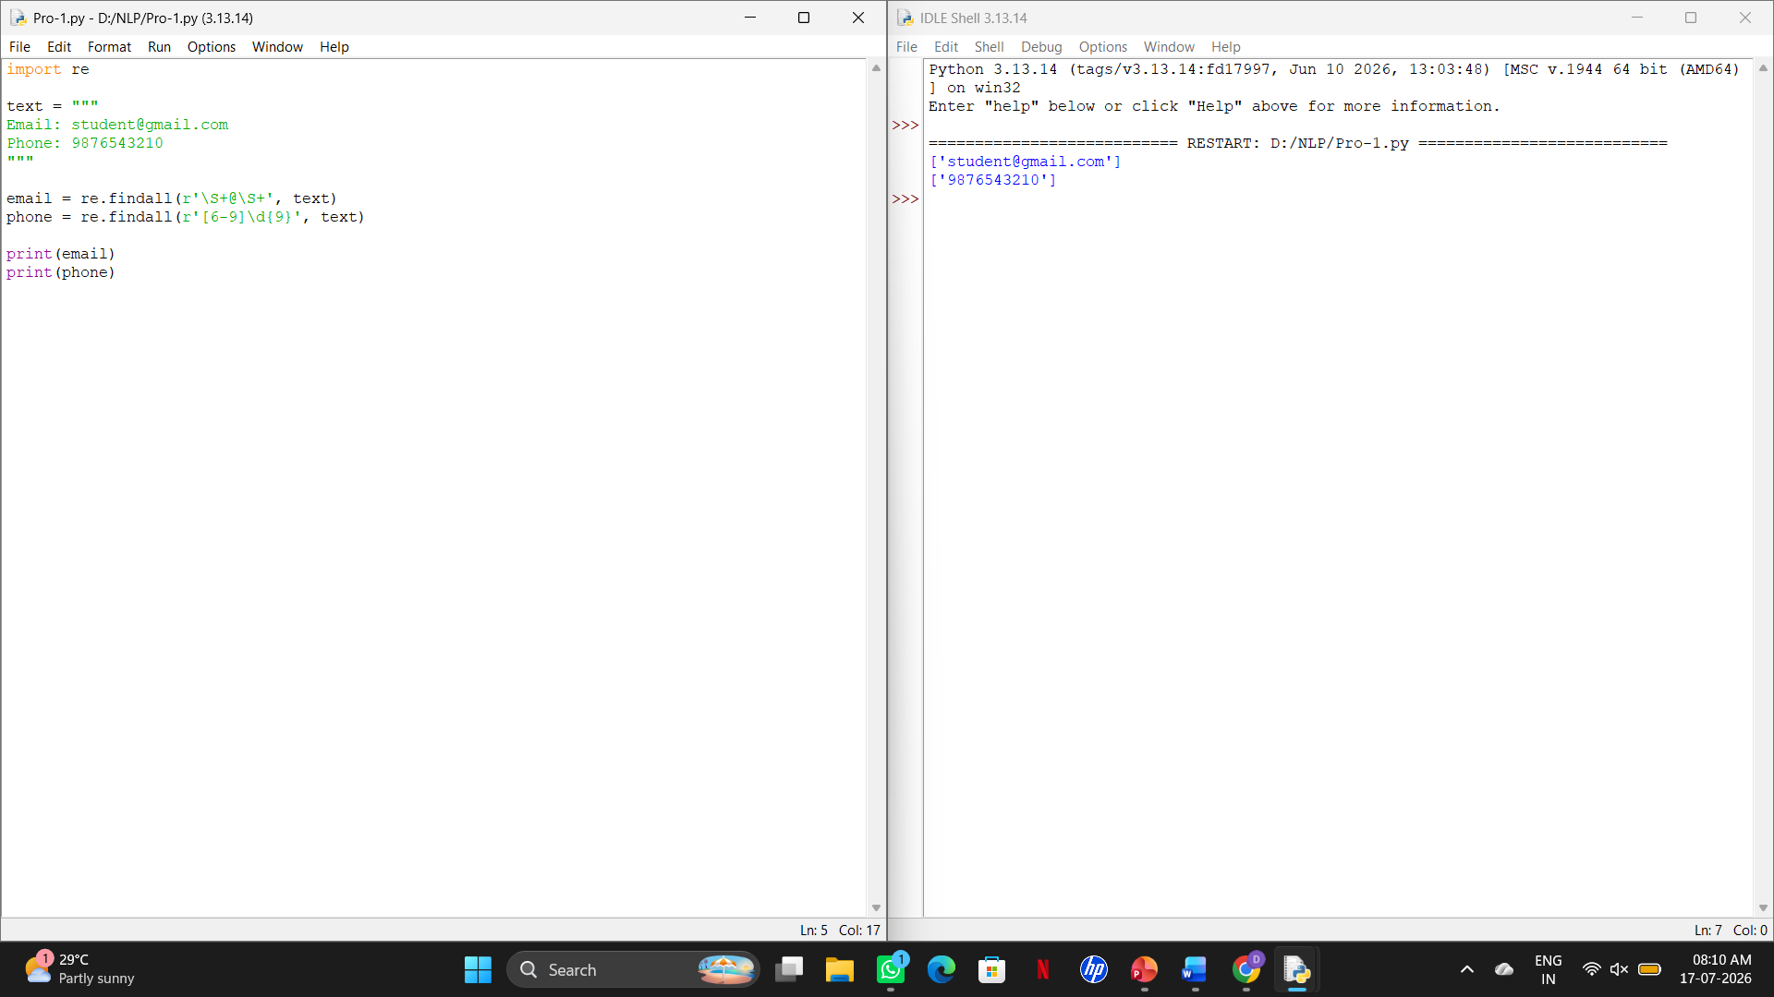
Python Demonstration

Slide 6
Advantages
Fast and accurate pattern matching.
Automates repetitive text-processing tasks.
Saves time and reduces manual effort.
Works efficiently with large datasets.
Easy to integrate with programming languages.
Limitations
Complex regex patterns can be difficult to understand.
Small syntax errors may lead to incorrect matches.
Not suitable for understanding the meaning or context of text.

Slide 7
Conclusion
Regular Expressions are a powerful tool for searching, validating, and extracting text.
They improve the efficiency and accuracy of text processing.
Regex is widely used in software development, data analytics, cybersecurity, and NLP.
Learning Regex helps developers automate text-related tasks and build intelligent applications.

Slide 8
Thank you

